Slide 1

Travelers Modeling Competition
Team Koalas

Slide 2
Table of contents
Data Pre-processing
Variable Selection & Feature Engineering
Methodology – Possible Modeling Approaches
Best MODEL
Additional Predictor Variables

Slide 3
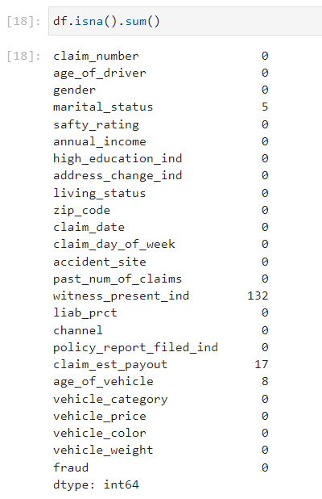
Missing Values
Owing to all our missing values being ‘NAs’, we searched for the missing values using the following code
RESULTS:
Out of a total of 17,998 rows, we found 154 NAs
Predictors having NAs
Witness_present_ind = Indicator for if a witness was present
Claim_est_payout = Estimated payout from the claim
Age_of_vehicle = Age of the vehicle
IMPUTATION:
Imputing is a great idea in cases where the ratio of missing values is significant, and the variables imputed aren’t very strongly correlated
In this case, data corruption through imputation was avoided since the MISSING VALUES = ~0.9% of the data set.

Slide 4
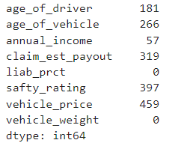
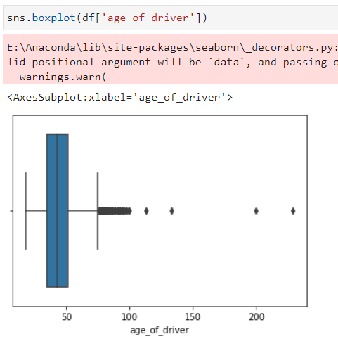
Outliers
OUTPUT
Outlier analysis was conducted which highlights the number of values present outside the Upper and Lower threshold limit, with Tail = 0.1 and Q = 3
Decision to keep or delete the outliers was taken on a case-by-case basis.
1. AGE_OF_DRIVER –
Drivers with ages above 95 was eliminated as the values present were between 100 to 250 and doesn’t make sense from a fraud perspective
2. SAFETY_RATING –
All values present are between 1 and 100 as standard rating practice. Outliers were present owing to heavier distribution of certain ratings. We kept all outliers for this variable.
3. ANNUAL_INCOME –
Records with ‘-1’ values in the ANNUAL_INCOME column were deleted as the ratio of fraud to no-fraud in this smaller sample was the same as the rest of the data set. Positive Outliers were kept, as INCOME can be varied and hence, could be useful for determining outcomes.

Slide 5
Table of contents
Data Pre-processing
Variable Selection & Feature Engineering
Methodology – Possible Modeling Approaches
Best MODEL
Additional Predictor Variables

Slide 6
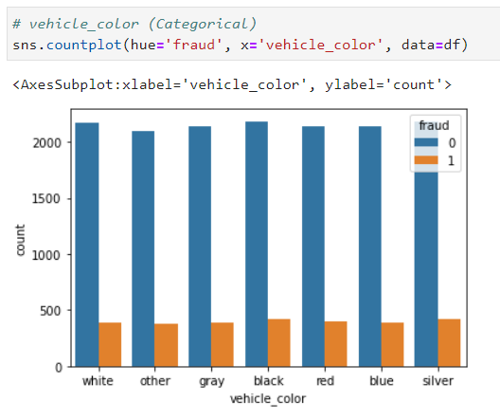
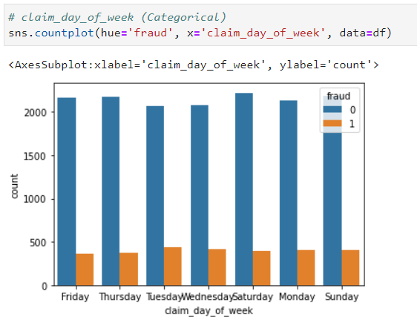
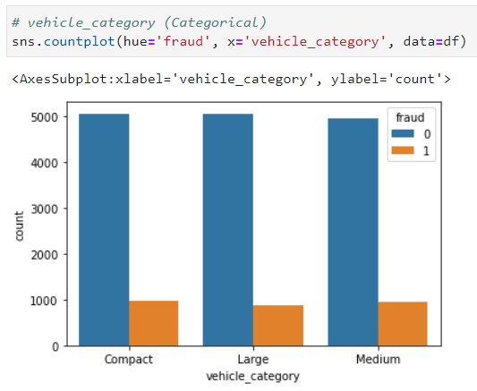
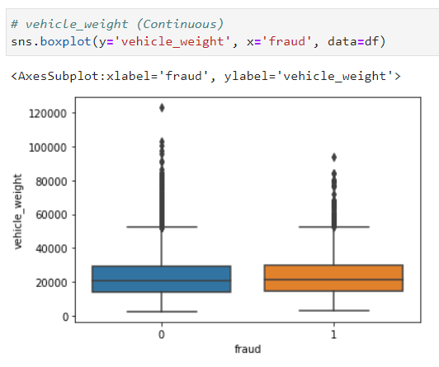
Variable Selection
Each variable was selected by visualizing its count for the FRAUD vs NO-FRAUD. Upon careful examination, the following variables were shortlisted for removal
Some additional variables removed – CLAIM_NUMBER, CLAIM_DATE, ZIP_CODE
VEHICLE_COLOR
CLAIM_DAY_OF_WEEK
VEHICLE_CATEGORY
VEHICLE_WEIGHT

Slide 7
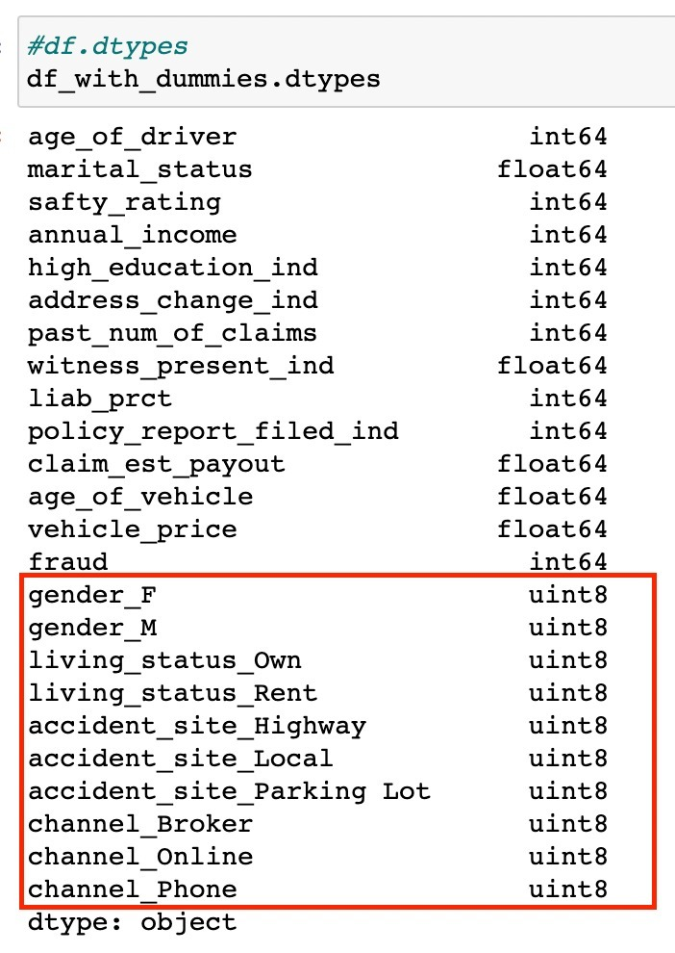
Feature Engineering
Feature Engineering included creation of dummy variables.
A dummy variable is one that takes only the value 0 or 1 to indicate the absence or presence of some categorical effect that may be expected to shift the outcome
Not creating dummy values would result in high coefficient values when creating regression models which in turn would not be good for the model performance
In the screenshot, we can observe the dummies created for the following variables:
GENDER : F or M
LIVING_STATUS : OWN or RENT
ACCIDENT_SITE : HIGHWAY, LOCAL or PARKING LOT
CHANNEL : BROKER, ONLINE or PHONE

Slide 8
Table of contents
Data Pre-processing
Variable Selection & Feature Engineering
Methodology – Possible Modeling Approaches
Best MODEL
Additional Predictor Variables

Slide 9
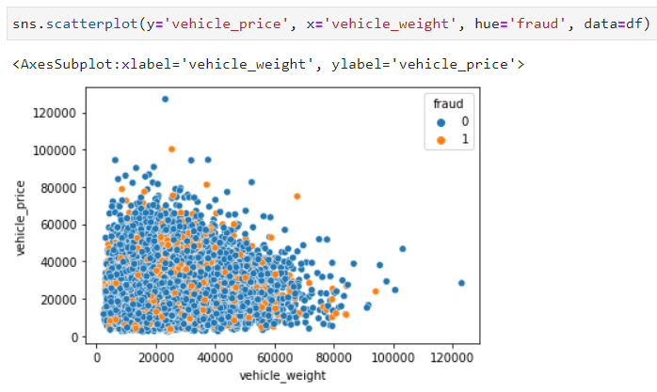
METHODOLOGY (1/2)
Our process started with RANDOM UNDERSAMPLING
The idea was to have equal number of 0s and 1s for the TARGET VARIABLE in the training data set.
This promotes the model to be trained well for predicted 1, since it is not biased by high number of 0s
This resulted in 5,586 entries in the training data set.
Next, we wanted to check whether the data in linear or non-linear.
Since this is a classification problem, we plotted two continuous variables with target variable as overlay
The data output was mixed and cannot be separated, hence, it is non-linear
When the model is non-linear, the following methods and inclined to work well
LOGISTIC REGRESSION
RANDOM FOREST CLASSIFIER
XGB CLASSIFIER

Slide 10
METHODOLOGY (2/2)
LOGISTIC REGRESSION
RANDOM FOREST CLASSIFIER
XGB CLASSIFIER
Logistic regression was the first model to be used because it is the simplest classification algorithm
The idea was to test out how the model works to get baseline performance for comparison with other models
Logistic regression also provides the variables importance to the model
Decision tree tends to overfit. Hence, we can either prune or combine multiple trees.
Random forest was used as it is the combination of multiple decision trees.
Theoretically, majority of right results compensates for incorrect outcomes of few trees and hence, the whole model performs better: No overfitting
XGBoost pushes the limit of computational resources for boosted tree algorithms.
Unlike other machine learning models, this algorithm helps reduce overfitting by using regularizing the training data.
That is why after trying out the random forest classifier and seeing good results we tried the XGB Classifier.

Slide 11
Table of contents
Data Pre-processing
Variable Selection & Feature Engineering
Methodology – Possible Modeling Approaches
Best MODEL
Additional Predictor Variables

Slide 12
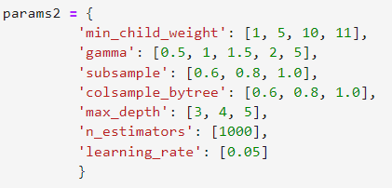
Best Model – XGB classifier
Our final model was the XGB Classifier as it had the best RECALL SCORE¹ out of the 3 models.
The parameter tuning for the XGB Classifier was done using trial and error and through externally available articles.
After numerous attempts, we came with the following HYPERPARAMETERS:
1. RECALL SCORE = Number of actual positives identified correctly

Slide 13
Table of contents
Data Pre-processing
Variable Selection & Feature Engineering
Methodology – Possible Modeling Approaches
Best MODEL
Additional Predictor Variables

Slide 14
Additional predictor variables
In addition to the existing variables, collecting information with respect to the below variables can prove to be useful in making a more accurate model -
EMPLOYMENT STATUS – Even though ANNUAL INCOME is registered; a recently lost job could be a motivator for a FALSIFIED CLAIM.
TIME SINCE LAST CLAIM – Higher frequency of claim could point towards a potential fraud or incompetence towards driving; identifying both cases could help the financial institution
TIME SINCE POLICY INCEPTION – Immediate claim after starting a policy could also point towards a fraudulent claim; Could be a coincidence, but a case to be thoroughly investigated before payout
ASSOCIATED PARTY INCIDENT – Involvement of another party in an accident event reduces the likelihood of a fraudulent claim

Slide 15
THANK YOU
Team Koalas

